Slide 1

COVID-19 DATA ANALYSIS USING X-RAYS VIA CNN WITH OUTBREAK PREDICTION AND DATA VISUALIZATION
SECTION :- 6C
BATCH NO. :- C1
USN-1DS19EC128 (SEC-C) SHRISHTI SINGH
USN-1DS19EC132 (SEC-C) SOURAV SHARMA
USN-1DS19EC143 (SEC-C) TANISH RAI
USN-1DS19EC150 (SEC-C) VAIBHAV KHANNA
SECTION COORDINATOR :- PROF. VIDYASHREE K.N.
MINI PROJECT GUIDE :-
PROF. NIRMALA Y.N.

Slide 2
INTRODUCTION
As we know, how the COVID-19 pandemic hit the whole world really hard, destroyed the economy of even the leading nations of the world, brought the administration to a standstill and severely affected the healthcare services globally.
At this moment of plight, the on-demand healthcare facilities crumbled and there was an acute shortage of resources to treat the masses effectively.

Slide 3
PROBLEM STATEMENT AND OBJECTIVES
People with suspected COVID-19 need to know quickly whether they are infected, so they can receive appropriate treatment, self-isolate, and inform close contacts but there are various shortcomings :-
Blood tests are costly (not affordable by all sections of the society).
Blood tests take time to conduct (approx 5 to 6 hours per patient)
The Rapid Spread Of the Virus poses a serious threat to even the life of the doctors and the medical team.
Extent of The Spread In the Body Can be detected using Deep Learning Models And CNN within minutes.
If we can analyse the present situation due to this havoc-causing Pandemic,
we can use this meaningful information for future-predictive events also.

Slide 4
LITERATURE SURVEY
RESEARCH PAPER | AUTHORS | PUBLISH YEAR | ABSTRACT
Research on Classification of COVID-19 Chest X-Ray Image Modal Feature Fusion Based on Deep Learning. | Daniel Cafoulla, Yanzhong Zhao, Qianchuan Zhao. | 25 August, 2021 | Deep learning techniques are widely used to design robust classification models in several areas such as medical diagnosis tasks in which it achieves good performance.
Impacts of COVID-19 Pandemic on Geopolitics, Health, Economics, Education and Sociocultural Events. | Hamrouni AM , Sharif RS, Sharif SI, Hassanein MM , Abdullkarem AR. | 5 May, 2022 | Governments from around the world taking unprecedented measures to mitigate the serious effects of the pandemic.
A Deep Learning Approach for the Detection of COVID-19 from Chest X-Ray Images using Convolutional Neural Networks | Aditya Saxena, Shamsheer Pal Singh | 24 January, 2022 | Due to the high availability of large-scale annotated image datasets, great success has been achieved using convolutional neural network for image analysis and classification.

Slide 5
METHODOLOGY
Using CNN and Deep-Learning Algorithms, we intend to implement a trained model having very high accuracy ( upto 98% ) to detect whether the patient is COVID-19 positive.
By feeding the X-Rays or MRI’s or CT scans to a database of numerous images belonging to patients with COVID-19, healthy individuals and people affected with viral pneumonia.
DEEP-LEARNING
Deep learning is a type of machine learning and artificial intelligence (AI) technique that imitates the way humans gain certain types of knowledge.
Deep learning is a class of machine learning algorithms that uses multiple layers to progressively extract higher-level features from the raw input.
Deep learning is also known as neural organized learning and happens when artificial neural networks learn from large volumes of data.

Slide 6
Convolutional Neural Networks (CNN)
CNN or the convolutional neural network (CNN) is a class of deep learning neural networks.
In short think of CNN as a machine learning algorithm that can take in an input image, assign importance (learnable weights and biases) to various aspects/objects in the image, and be able to differentiate one from the other. CNN works by extracting features from the images.
The role of CNN is to reduce the images into a form that is easier to process, without losing features critical towards a good prediction. This is important when we need to make the algorithm scalable to massive datasets.

Slide 7
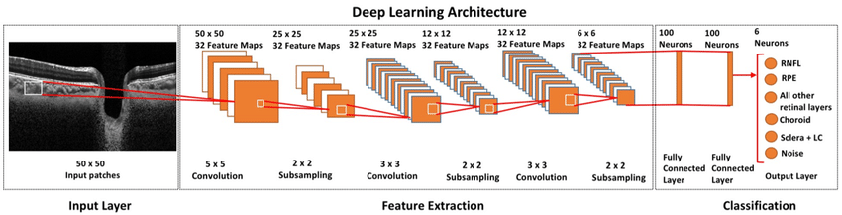
Convolutional Layers
In this layer, the mathematical operation of convolution is performed between the input image and a filter of a particular size MxM.
By sliding the filter over the input image, the dot product is taken between the filter and the parts of the input image with respect to the size of the filter (MxM).
The output is termed as the Feature map which gives us information about the image such as the corners and edges.

Slide 8
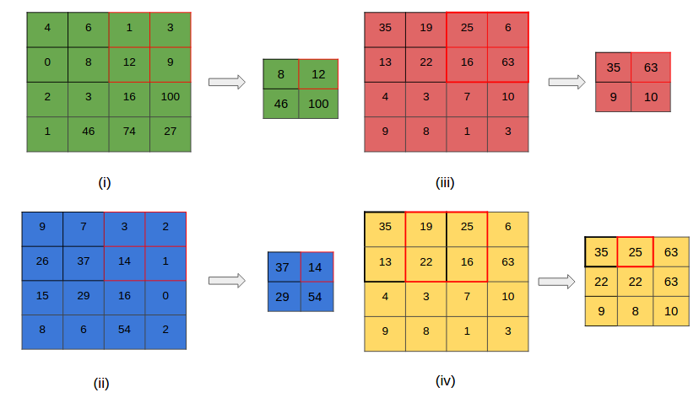
Pooling Layers
The primary aim of this layer is to decrease the size of the convolved feature map to reduce the computational costs.
Depending upon method used, there are several types of Pooling operations.
In Max Pooling, the largest element is taken from feature map.

Slide 9
FULLY CONNECTED LAYERS
In this, the input image from the previous layers are flattened and fed to the FC layer.
The flattened vector then undergoes few more FC layers where the mathematical functions operations usually take place.
In this stage, the classification process begins to take place.
DROPOUT
When all the features are connected to the FC layer, it can cause overfitting in the training dataset.
Overfitting occurs when a particular model works so well on the training data causing a negative impact in the model’s performance when used on a new data.
To overcome this problem, a dropout layer is utilised wherein a few neurons are dropped from the neural network during training process resulting in reduced size of the model.

Slide 10
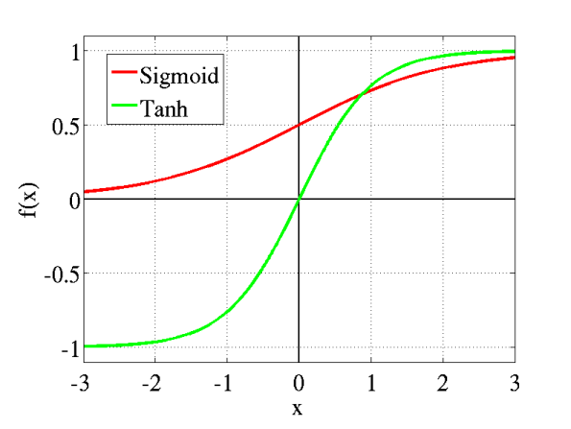
ACTIVATION FUNCTIONS
They are used to learn and approximate any kind of continuous and complex relationship between variables of the network.
It decides which information of the model should fire in the forward direction and which ones should not at the end of the network.
It adds non-linearity to the network.
There are several commonly used activation functions such as the ReLU, Softmax, tanH and the Sigmoid functions.
Each of these functions have a specific usage. For a binary classification CNN model, sigmoid and softmax functions are preferred.

Slide 11
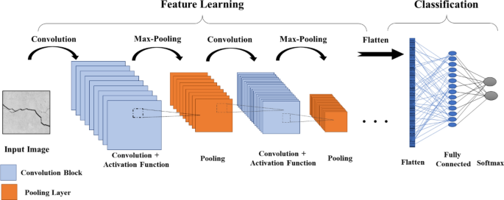
CNN X-RAY FEATURE EXTRACTION AND CLASSIFICATION

Slide 12
PACKAGES USED:-
NUMPY, PANDAS, MATPLOTLIB
FOLIUM, PLOTLY
KERAS (DENSE, CONV2D, MAXPOOL2D, DROPOUT, FLATTEN, MODELS, SEQUENTIAL,etc).
SOFTWARES TO BE USED :-
DATASETS USED :-
For COVID-Positive Cases => https://www.kaggle.com/datasets/paultimothymooney/chest-xray-pneumonia
COVID -Negative Cases =>
https://github.com/ieee8023/covid-chestxray-dataset
For chest X-Ray dcm, jpg, or png are preferred. Not only X-Rays but CT-Scans can also be used as a dataset for the project.
For Part-2 of the Project requiring Exploratory Data Analysis And Visualisation :- https://github.com/laxmimerit/Covid-19-Preprocessed-Dataset.git

Slide 13
PART-2
PERFORMING EXPLORATORY DATA ANALYSIS ON COVID-19 DATASET
Exploratory Data Analysis refers to the critical process of performing initial investigations on data so as to discover patterns, to spot anomalies, to test hypothesis.
Visual exploratory data analysis (V-EDA) offers a user-friendly data visualization model to evaluate the impact of the pandemic.
It allows one to observe visual patterns of trends.
We will be making use of multiple Python Libraries to visualize the data using Bar-Plots, Scatter-Plots, Counter-Plots, Pie-Charts, etc.

Slide 14
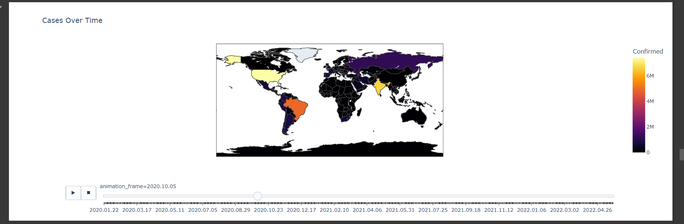
CHLOROPLETH MAPS VISUALISATION

Slide 15
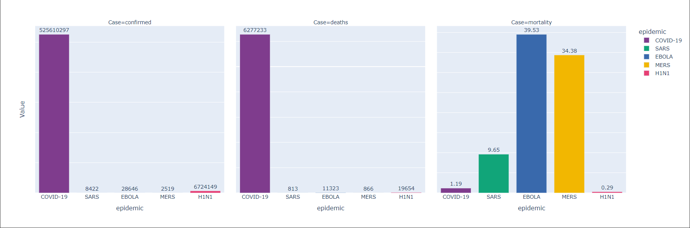
COMPARISON OF OTHER PANDEMICS WITH COVID-19

Slide 16
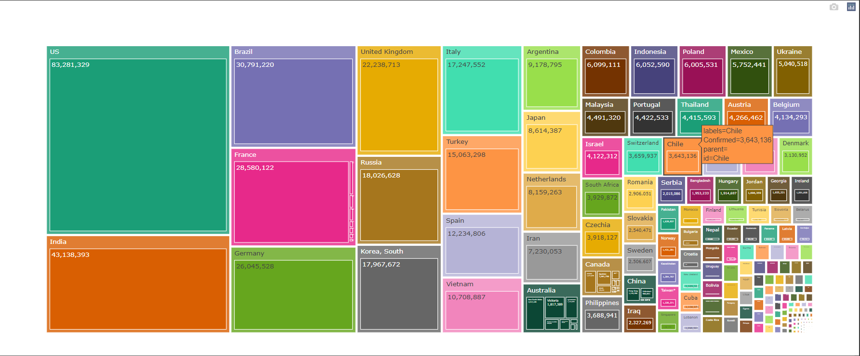
TREEMAP ANALYSIS

Slide 17
PART-3
CONVERTING THE ML MODEL TO A WEB-BASED APPLICATION
MODEL
Connecting the Deep Learning Model to A Web-Based Application wherein the user shall be able to make choices which data to be rendered or visualised on the screen.

Slide 18
FUNCTIONALITIES:-
SEARCH OPERATION :-
The user is provided with a search section to find the desired Country’s Name from a list of 209 countries provided.
The list has an updation feature wherein the Spell-Check Mechanism is implemented.
In case, no spelling of the Country name entered by the user matches one from the list, a retype message is presented.
Closing the Search Bar functionality with a visual Cross Symbol illustrated.
DYNAMIC UPDATION OF VISUAL CHARTS:-
Used Chart.JS library to produce dynamically updating visualisations.
Rendered the charts on the laptops or mobile screen.
Enabled User-Dependant Choice Of Operations.

Slide 19
RESPONSIVENESS USING MEDIA QUERIES
Whenever we try to portray a laptop or monitor layout designed application on mobile devices, the display is neither user-interactive nor preferable.
Made use of Media Queries on the project to provide a user-interactive look to the Web-App.
Enables the user to locate the Application without delving into any hassles of installation or memory consumption.
LIVE LINK TO THE APPLICATION :
https://covid-visualisation-2019.netlify.app/

Slide 20
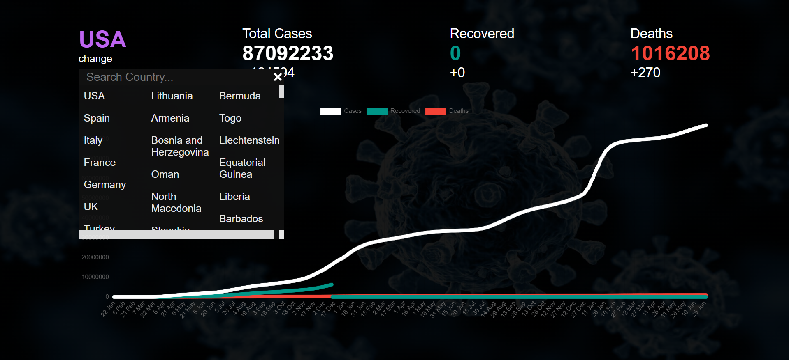
COVID-19 WORLD DATA VISUALIZER

Slide 21
RESULTS
Achieved upto a maximum accuracy of 98.33% on validation dataset and upto 98.96% accuracy on training dataset in detecting COVID-19 +ive and COVID-19 -ive patients.
Analysed the World-Data Trends along with dynamically updating and changing Visualisations.
Performed TreeMap Analysis on the World COVID-19 Data.
Performed The Comparison between the Other Past/Previously Occurred Pandemics and COVID-19.
Converted our Machine Learning Model into a web-based application.
Improved the user-interactivity with respect to our project.

Slide 22
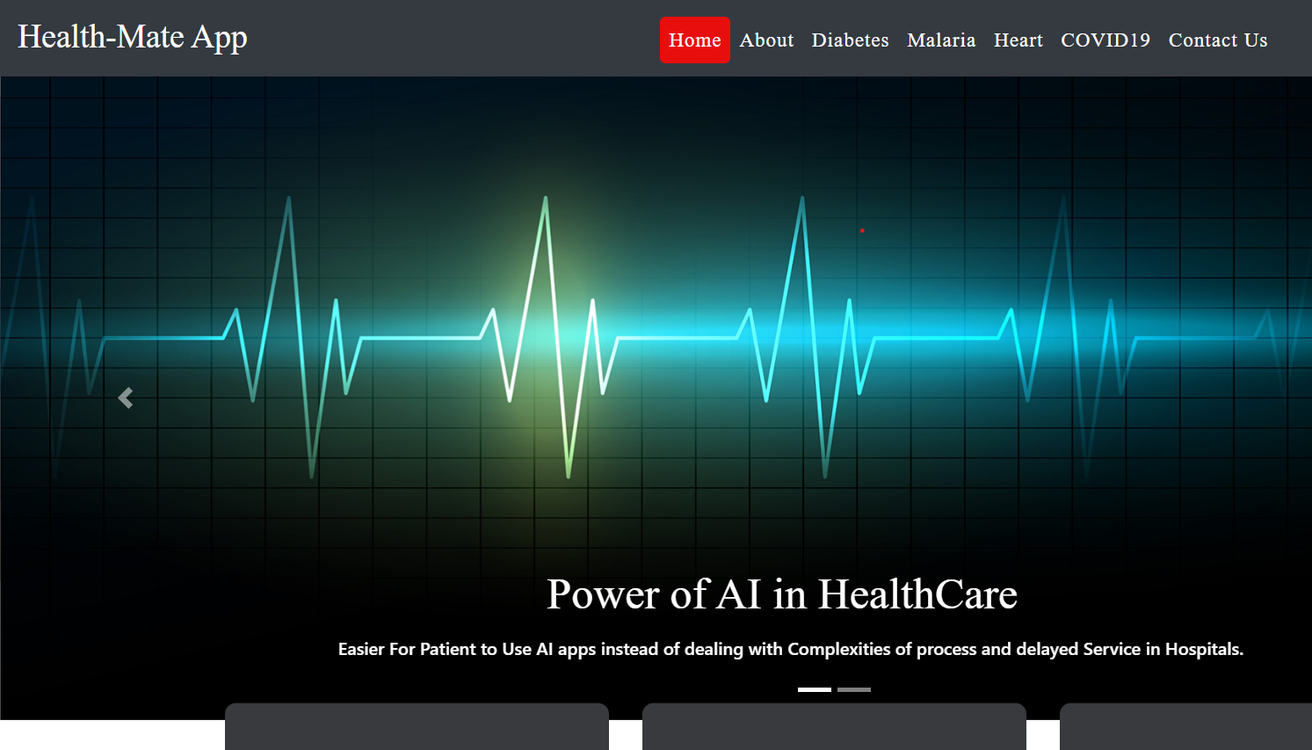
RESULTS:

Slide 23
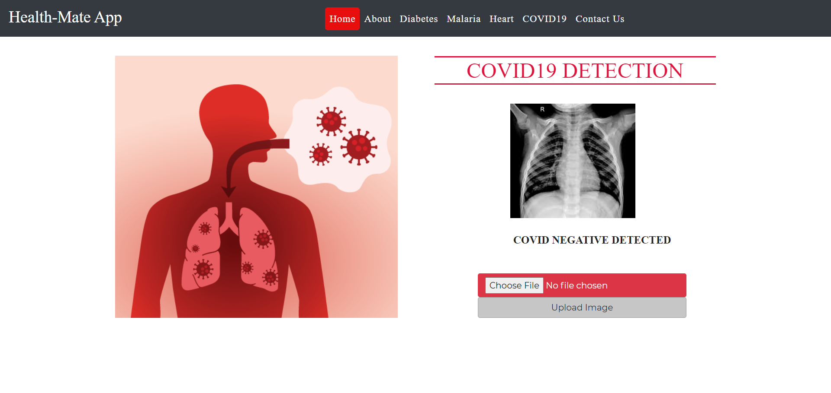
RESULTS

Slide 24
REFERENCES
Aditya Saxena, Shamsheer Pal Singh, “ A Deep Learning Approach for the Detection of COVID-19 from Chest X-Ray Images using Convolutional Neural Networks”, ( 2022).
Josh Patterson, Adam Gibson’s “Deep Learning - A Practitioner Approach,” 2017.
Pillalamarry Mahesh1, Yakkala Gnana Prathyusha1, Botlagunta Sahithi1 and S Nagendram2, “Covid-19 Detection from Chest X-Ray using Convolution Neural Networks”, (2021).
WHO Director-General’s opening remarks at the media briefing on COVID-19 - 11 March World Health Organization, (2020).
JHU, COVID-19 Dashboard by the Center for Systems Science and Engineering (CSSE) at Johns Hopkins University (JHU), (2020).

Slide 25
THANK YOU

